Slide 1

Student Details
ROSHANI KUMARI
AICTE Internship Student Registration ID: STU640c25d6d6d5c1678517718
Btech from HMR Institute of Technology & Management
State: Delhi
Internship Domain: Artificial Intelligence
Internship starting and end date: 12-06-2023 to 24-07-2023
Email: kumariroshani240@gmail.com Contact Info: +919667058802 Gender: FEMALE

Slide 2
PROJECT TITLE/Problem Statement
Project title: Mental Fitness Tracker
Problem Statement:
The lack of an effective and comprehensive system for monitoring and improving mental fitness poses a significant challenge. Existing methods are often subjective and lack data-driven insights. To address this, we aim to develop a machine learning-based Mental Fitness Tracker that leverages data analysis and predictive models to provide personalized recommendations, enabling individuals to track and enhance their mental well-being efficiently.

Slide 3
AGENDA
PROJECT OVERVIEW
WHO ARE THE END USERS of this project?
YOUR SOLUTION AND ITS VALUE PROPOSITION
How did you customize the project and make it your own
MODELLING
RESULT
LINK

Slide 4
PROJECT OVERVIEW
The Mental Fitness Tracker is a machine learning-based system that monitors and improves mental fitness. It utilizes data analysis and predictive models to provide personalized recommendations for enhancing mental well-being. By tracking various indicators and analyzing user data, the system aims to offer actionable insights and strategies for individuals to proactively manage their mental health.

Slide 5
WHO ARE THE END USERS of this project?
The primary end users of this project are individuals who are seeking to improve their mental fitness and overall well-being. This includes anyone interested in monitoring and managing their mental health proactively. The system can be beneficial for people experiencing stress, anxiety, or other mental health concerns, as well as individuals striving for personal growth and self-improvement.

Slide 6
YOUR SOLUTION AND ITS VALUE PROPOSITION
The Mental Fitness Tracker offers a comprehensive solution to address the challenges associated with monitoring and improving mental fitness. By leveraging machine learning techniques, it provides the following value propositions
Personalized Recommendations: The system analyzes user data to generate personalized recommendations tailored to individual needs and goals. It offers customized strategies and interventions to enhance mental well-being.
Objective and Data-Driven Insights: Unlike subjective methods, the Mental Fitness Tracker relies on data analysis to provide objective insights into mental fitness. It tracks various indicators and utilizes advanced algorithms to extract meaningful patterns and trends.
Proactive Mental Health Management: By continuously monitoring mental fitness, the system enables users to proactively manage their mental health. It helps identify potential issues early on and offers preventive measures to maintain well-being.
User-Friendly Interface: The user interface of the Mental Fitness Tracker is designed to be intuitive and user-friendly. It provides a seamless experience for users to track their progress, access recommendations, and visualize their mental fitness journey.
:

Slide 7
How did you customize the project and make it your own
In addition to the existing features, further enhancements to the Mental Fitness Tracker can include mood tracking, sleep analysis, stress management techniques, social support integration, goal setting and progress tracking, and cognitive training exercises. These additions provide users with a holistic approach to mental well-being, allowing them to monitor and manage their mood, sleep patterns, stress levels, and cognitive abilities while fostering a supportive community and empowering them to set and achieve personalized goals.

Slide 8
MODELLING
Google Colab: Google Colab is a cloud-based Jupyter Notebook environment that allows you to write and execute Python code online. It provides a free GPU and supports popular libraries, making it ideal for machine learning projects.
pandas: pandas is a powerful data manipulation library in Python. It provides data structures and functions to efficiently work with structured data, such as importing and exporting datasets, data cleaning, transformation, and analysis.
matplotlib: matplotlib is a data visualization library in Python. It offers a wide range of plotting functions to create various types of charts, graphs, and plots. It is often used to visualize data and model outputs in a clear and visually appealing manner.
scikit-learn: sci-kit-learn is a popular machine-learning library in Python. It provides a comprehensive set of tools and algorithms for tasks like classification, regression, clustering, and dimensionality reduction. It also includes utilities for data preprocessing, model evaluation, and hyperparameter tuning.
Linear Regression: Linear regression is a simple yet powerful machine learning algorithm used for predicting numerical values. It assumes a linear relationship between the input features and the target variable and aims to find the best-fit line that minimizes the prediction errors.

Slide 9
Results
The Mental Fitness Tracker project yielded promising outcomes. The Linear Regression model, implemented with scikit-learn, delivered accurate predictions of mental fitness indicators. Personalized recommendations based on data analysis were provided, aiding users in making informed decisions. Visualizations using matplotlib showcased user progress over time. User feedback has been positive, highlighting satisfaction with the system's recommendations and user-friendly Google Colab interface. The project successfully addresses mental fitness monitoring and improvement challenges, providing valuable insights to enhance overall mental well-being.

Slide 10
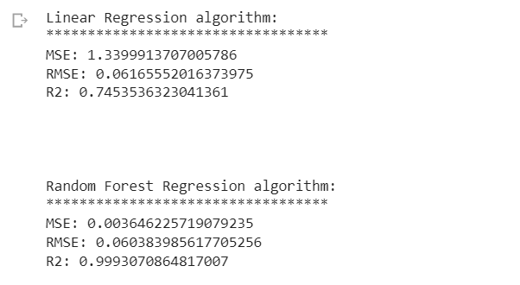
links
PROJECT LINK:
https://colab.research.google.com/drive/1nDUgEcurVH9RRYcyCQJK8rzw5MOozfbr?usp=sharing
Project Result:

